Slide 1
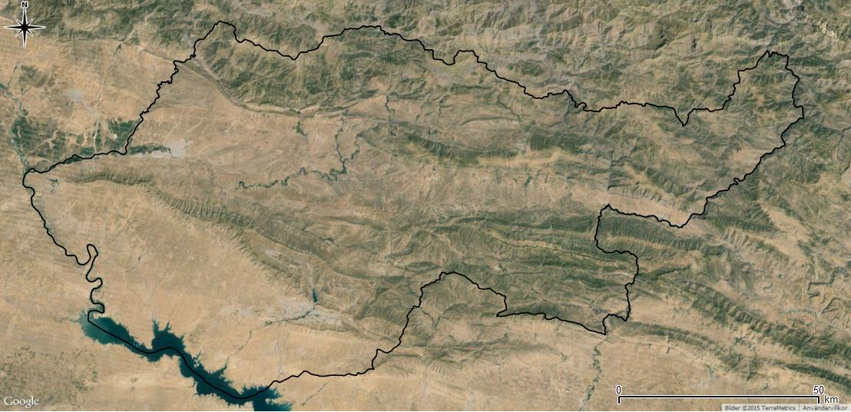
CROPLAND CLASSIFICATION USING OPTICAL AND RADAR DATA
TEAM: AKASH A (191EC102), NAVRATAN (191EC133) AND ROHAN J (191EC147)
MENTOR: DR. RAGHAVENDRA B S

Slide 2
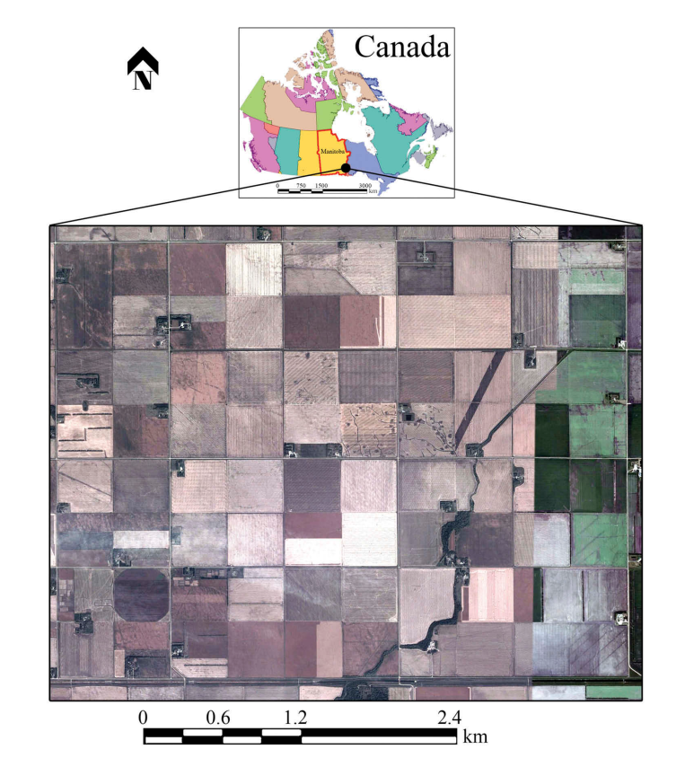
A BASIC IDEA
Aim: To develop an ML model that can efficiently label croplands using data from remote sensing instruments
Motivation: Possibility of use in agriculture planning and management activities at national and global scales
Area under Study: Southwest district of Winnipeg, Manitoba, Canada - Covered by various annual crops
Seven different types of crops - Broadleaf, Soybeans, Canola, Wheat, Peas, Corn and Oats

Slide 3
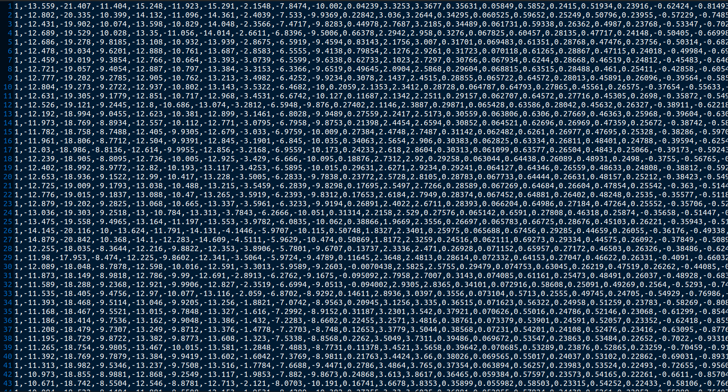
UNDERSTANDING THE DATASET
Dataset consists of bitemporal optical and RADAR features
RapidEye Satellites - Collected optical features from five spectral bands - R, G, B, NIR and RE
UAVSAR - airborne SAR sensor operating in full polarization mode collected radar features
Each row corresponds to a single pixel of data; First column represents label followed by 174 features

Slide 4
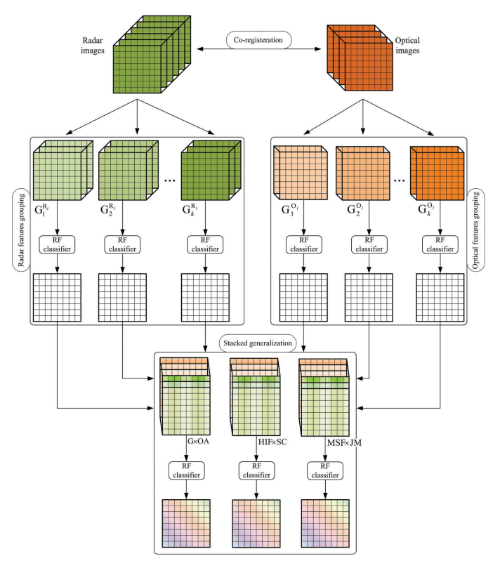
PROPOSED CROP MAPPING FRAMEWORK
Feature Extraction and Grouping
Classification of Each group
Stacking the Results of Each Group
Final Classification

Slide 5
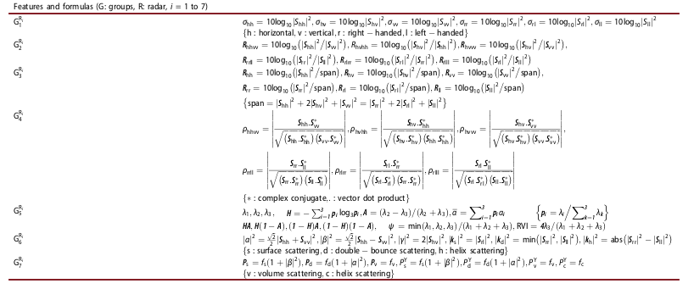
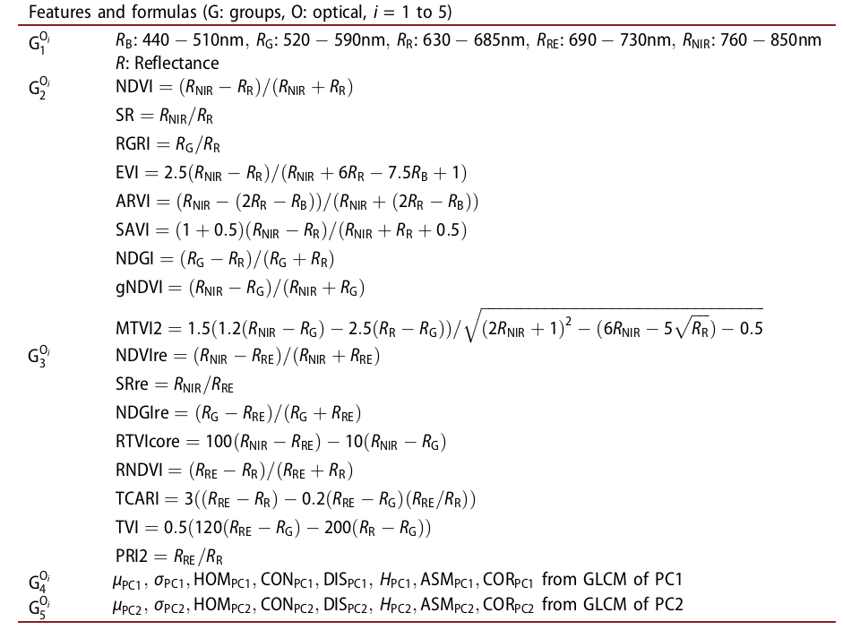
STEP 1: FEATURE EXTRACTION AND GROUPING
RADAR FEATURES
OPTICAL FEATURES

Slide 6
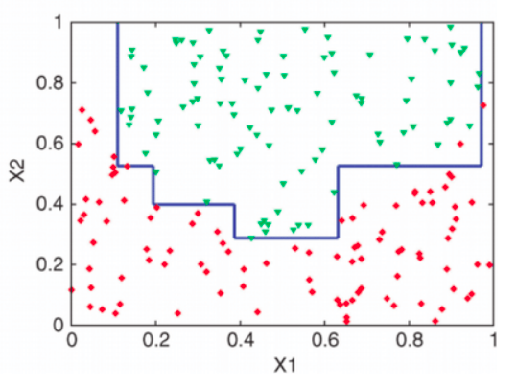
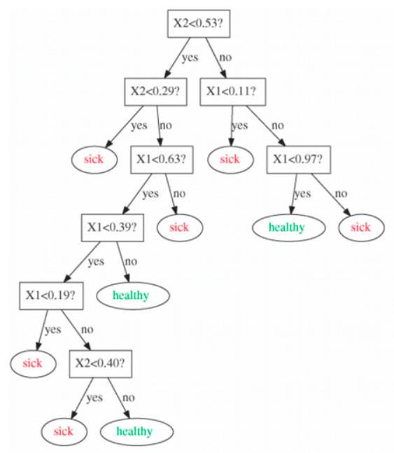
STEP 2: TRAINING EACH OF THE FEATURE GROUPS
Random Forest (RF) Classifier was selected owing to its stable nature and research support for current application
RF Classifier: - A classifier based on decision tree classification
Decision Tree: - A tree based ML model; Uses a series of questions to come up with the hypothesis function
Disadvantage of Decision Trees: - Weak classifier, often results in overfitting the training set

Slide 7
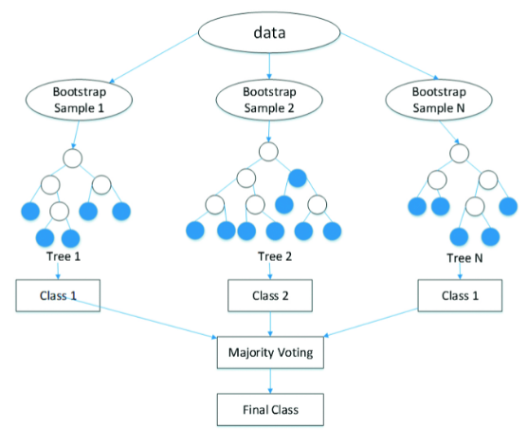
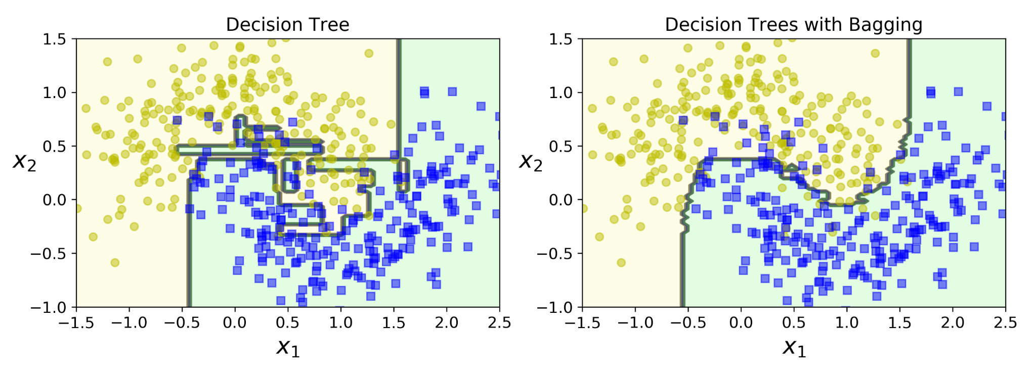
STEP 2 CONTD. : THE RANDOM FOREST CLASSIFIER
Based on ensemble learning: - Combines results of several weak classifiers to get a stronger classifier
Optimal number of decision trees used - Each given a subset of the training set and a subset of the features by bootstrapping the training set (Number of features given to each tree is important)
Majority voting used on prediction of each decision tree to predict the result

Slide 8
STEPS 3 AND 4: STACKING AND FINAL CLASSIFIER
Traditional approaches for stacking include using max voting on predictions of each classifier or using another ML model to select more important features. Three optimized approaches were suggested. Another RF classifier was used after the stacking.
Approach 1 - Multiply the predictions on the training of each group by the Overall Accuracy (OA) of that group and then use it for next phase of training - more accurate groups get greater weight
Approach 2 - Select a certain number of highest important features of each group during classification and use these for the next stage after multiplying by the importance scores and stacking
Approach 3 - Select the most separable features of each group using Jeffries-Matusita (JM) distance and use these features for the next stage of classification

Slide 9
IMPLEMENTATION
DATASET
RADAR FEATURE GROUPS ON DATE 1
RADAR FEATURE GROUPS ON DATE 2
OPTICAL FEATURE GROUPS ON DATE 1
OPTICAL FEATURE GROUPS ON DATE 2
RF CLASSIFIER AND OA STACKING
RF CLASSIFIER AND OA STACKING
RF CLASSIFIER AND OA STACKING
RF CLASSIFIER AND OA STACKING
OA STACKING AND CLASSIFIER
OA STACKING AND CLASSIFIER
OA STACKING AND CLASSIFIER

Slide 10
CODE SEGMENT FOR RF CLASSIFICATION
from sklearn.ensemble import RandomForestClassifier
from sklearn.metrics import accuracy_score
Xtrain_group1_radar_date1 = balanced_training_data[:,[1, 2, 3, 4, 5, 6]]
classifier_radar1_date1 = RandomForestClassifier(n_estimators = 500, max_features = 'sqrt')
classifier_radar1_date1.fit(Xtrain_group1_radar_date1, y_train)
X_test_radar1_date1 = data[:, [1, 2, 3, 4, 5, 6]]
y_test = data[:, 0]
y_predicted_radar1_date1 = classifier_radar1_date1.predict(X_test_radar1_date1)
OA_group1_radar_date1 = accuracy_score(y_test, y_predicted_radar1_date1)
print('Overall Accuracy of Radar Group 1 on date 1: %f\n'%(OA_group1_radar_date1))
y_predict_train_group1_radar_date1 = classifier_radar1_date1.predict(Xtrain_group1_radar_date1)
next_group1_date1_radar = y_predict_train_group1_radar_date1*OA_group1_radar_date1
next_group1_date1_radar = np.reshape(next_group1_date1_radar, (-1, 1))

Slide 11
CODE SEGMENT FOR STACKING
Xtrain_radar_date1 = np.hstack((next_group1_date1_radar, next_group2_date1_radar, next_group3_date1_radar, next_group4_date1_radar, next_group5_date1_radar, next_group6_date1_radar, next_group7_date1_radar))
classifier_radar_date1 = RandomForestClassifier(n_estimators = 500, max_features = 'sqrt')
classifier_radar_date1.fit(Xtrain_radar_date1, y_train)
X_test_radar_date1 = np.hstack((y_predicted_radar1_date1*OA_group1_radar_date1, y_predicted_radar2_date1*OA_group2_radar_date1, y_predicted_radar3_date1*OA_group3_radar_date1, y_predicted_radar4_date1*OA_group4_radar_date1, y_predicted_radar5_date1*OA_group5_radar_date1, y_predicted_radar6_date1*OA_group6_radar_date1, y_predicted_radar7_date1*OA_group7_radar_date1))
X_test_radar_date1 = np.transpose(np.reshape(X_test_radar_date1, (7, -1)))
y_predicted_radar_date1 = classifier_radar_date1.predict(X_test_radar_date1)
OA_radar_date1 = accuracy_score(y_test, y_predicted_radar1_date1)
print('Overall Accuracy of radar data on date 1 : %f\n'%(OA_radar_date1))

Slide 12
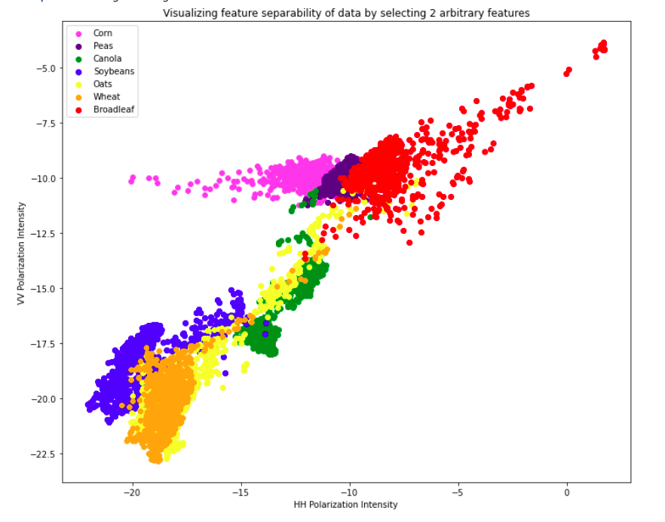
RESULTS
RADAR GROUPS FOR DATE 1 | OVERALL ACCURACY
G1 | 60.33%
G2 | 52.10%
G3 | 51.28%
G4 | 49.59%
G5 | 61.88%
G6 | 50.09%
G7 | 50.47%

Slide 13
RESULTS - CONTD.
RADAR GROUPS FOR DATE 2 | OVERALL ACCURACY
G1 | 75.24%
G2 | 48.05%
G3 | 45.68%
G4 | 37.48%
G5 | 75.96%
G6 | 63.58%
G7 | 66.97%
OPTICAL GROUPS FOR DATE 1 | OVERALL ACCURACY
G1 | 66.67%
G2 | 59.53%
G3 | 65.67%
G4 | 45.32%
G5 | 38.95%
OPTICAL GROUPS FOR DATE 2 | OVERALL ACCURACY
G1 | 66.28%
G2 | 40.33%
G3 | 56.25%
G4 | 37.55%
G5 | 32.05%

Slide 14
RESULTS - CONTD.
STACKED FEATURES | OVERALL ACCURACY
RADAR FEATURES - DATE 1 | 60.33%
RADAR FEATURES - DATE 2 | 75.24%
RADAR FEATURES | 70.04%
OPTICAL FEATURES - DATE 1 | 66.67%
OPTICAL FEATURES - DATE 2 | 66.28%
OPTICAL FEATURES | 59.33%
RADAR & OPTICAL FEATURES | 64.03%
Radar features were observed to offer a much higher overall accuracy as compared to optical feature groups
Each group was found to have a higher accuracy than a random classifier which verifies that the model has learnt to classify
Overall accuracy obtained was 64.03% which ranks on an average scale for a multi-class classification problem

Slide 15
THE WAY FORWARD...
Attempt to improve the overall accuracy - try multiplying features by overall accuracy for further training instead of feature labels
Changing number of decision trees has no effect on Overall Accuracy - Try and find out why and possible solutions
Repeat the training using an imbalanced training set and observe results. Further, come up with other measures of accuracy apart from OA since the dataset is imbalance - F-Scores, Kappa coefficients
Try out other stacking algorithms and observe changes in the performance

Slide 16
REFERENCES
Iman Khosravi & Seyed Kazem Alavipanah (2019) A random forest-based framework for crop mapping using temporal, spectral, textural and polarimetric observations, International Journal of Remote Sensing, 40:18, 7221-7251, DOI: 10.1080/01431161.2019.1601285
https://www.analyticsvidhya.com/blog/2021/04/getting-into-random-forest-algorithms/

